Slide 1
UNIT 1
Cloud computing delivers on-demand computing services—like servers, storage, databases, software, analytics, and AI—over the internet, allowing users to access resources from remote data centers instead of owning physical hardware, often with pay-as-you-go pricing, offering flexibility, scalability, and cost efficiency.
It enables access to powerful IT infrastructure and tools instantly, making it ideal for businesses of all sizes to innovate and grow without heavy upfront investments.

Slide 2
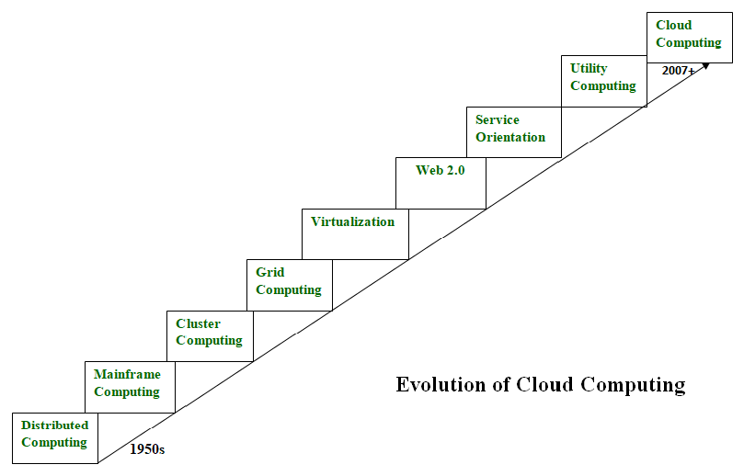

Slide 3
System Models for Distributed and Cloud Computing
1. Introduction to System Models
A system model defines how a distributed or cloud system is structured, how resources are organized, how nodes communicate, and how users see the system. According to Kai Hwang, system models help in:
Understanding distributed resource sharing
Designing scalable architectures
Managing computation, storage, and networking
Handling virtualization and cloud service delivery

Slide 4
System Model Classification
System models are grouped into:
Computing Models
Memory/Storage Models
Communication Models
Process Models-(Synchronous model and Asynchronous model)
Virtualization Models
Cloud Service Models
Deployment Models

Slide 5
Parallel Computing Model
Multiple processors execute tasks simultaneously.
Goals: Speedup, High performance, Throughput.
Used in HPC(High Performance computing) and scientific applications.
Based on:
Shared Memory Systems
Distributed Memory Systems
Hybrid Systems
Examples:
Supercomputers (Cray, IBM BlueGene)
GPUs (parallel cores)

Slide 6
Distributed Computing Model
Here, computation is done on autonomous networked computers, cooperating to solve problems.
Key characteristics :
Heterogeneity
Independent operating systems
Geographical distribution
No shared clock or memory
Scalability and openness
Examples:
Internet applications
Distributed databases
Microservices-based systems

Slide 7
Cluster Computing Model
A cluster is a tightly coupled collection of computers working as a single system.
Features:
High-speed LAN
Single System Image (SSI)
Load balancing
High availability
Parallel execution
Use Cases:
HPC clusters
Campus server clusters
Cloud back-end clusters

Slide 8
Grid Computing Model
Grids are loosely coupled, geographically distributed systems that share resources across multiple administrative domains.
Key features:
Large-scale resource federation
Virtual organizations
High-throughput computing
Task scheduling and resource allocation
Examples:
NASA Earth Observing System
CERN LHC Grid

Slide 9
Architectural (Physical) Models Defines the physical organization of hardware and servers.
Peer-to-Peer (P2P) Model
In P2P systems, every node is equally powerful and functions as both client and server.
Features:
Decentralized control
Self-scalability
Fault tolerant
Examples:
BitTorrent
Blockchain networks

Slide 10
Client–Server Architecture model
Clients send requests.
Servers process and respond.
Server types:
File servers
Web servers
Application servers
Example:
Database server + multiple clients

Slide 11
Multi-tier Architecture
Systems are divided into layers:
3 layers include:
Presentation layer (UI)
Application layer (business logic)
Database layer (storage)
Advantages:
Clear separation of concerns
Easy scalability
Better security

Slide 12
Communication Models-Defines how distributed nodes communicate.
Message Passing Model
Remote Procedure Call (RPC) Model
Remote Method Invocation (RMI)
Publish–Subscribe Model

Slide 13
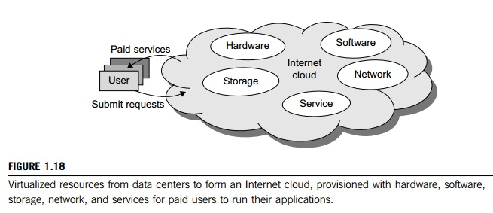
INTERNET CLOUDS

Slide 14
CLOUD SERVICE MODELS
Infrastructure as a Service(Iaas)
This model puts together infrastructures demanded by users—namely servers, storage, networks, and the data center fabric. The user can deploy and run on multiple VMs running guest OSes on specific applications. The user does not manage or control the underlying cloud infrastructure, but can specify when to request and release the needed resources.
Software as a Service(Saas)
This refers to browser-initiated application software over thousands of paid cloud customers. The SaaS model applies to business processes, industry applications, consumer relationship management (CRM), enterprise resources planning (ERP), human resources (HR), and collaborative applications. On the customer side, there is no upfront investment in servers or software licensing. On the provider side, costs are rather low, compared with conventional hosting of user applications.

Slide 15
Cloud Service Models
Platform as Service(Paas)
This model enables the user to deploy user-built applications onto a virtualized cloud platform. PaaS includes middleware, databases, development tools, and some runtime support such as Web 2.0 and Java. The platform includes both hardware and software integrated with specific programming interfaces. The provider supplies the API and software tools (e.g., Java, Python, Web 2.0, .NET). The user is freed from managing the cloud infrastructure.

Slide 16
NIST Cloud Computing Architecture There are five major actors in NIST cloud computing reference architecture, These actors are listed below
Cloud Consumer.
Cloud Provider.
Cloud Carrier.
Cloud Auditor.
Cloud Broker.

Slide 17
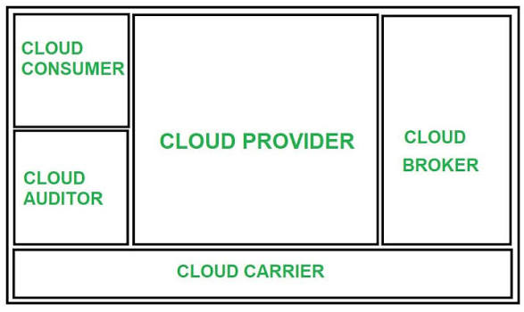
NIST CLOUD COMPUTING REFERENCE ARCHITECTURE

Slide 18
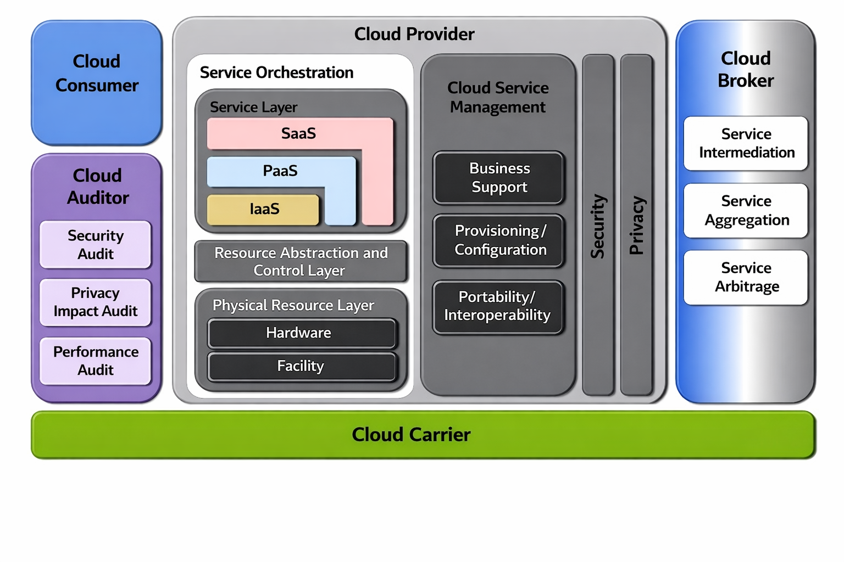

Slide 19
Cloud consumer
Cloud consumer is the main participants of cloud computing environment.
A cloud consumer is a person or organization that uses the cloud services such as SaaS, PaaS and IaaS.
A cloud consumer browses the service catalog provided by a cloud provider, cloud consumer requests the appropriate service.
Cloud provider sets up cloud environment for the service and make a contracts with the cloud consumer for the use of the service.
Cloud consumers need cloud Service Level Agreement(SLA).

Slide 20
Service Level Agreements
Service Level Agreements usually specify some parameters which are mentioned below:
Availability of the Service (uptime)
Latency or the response time
Service components reliability
Each party accountability
Warranties

Slide 21
Cloud consumer
SLA act as a agreement for technical performance requirements provided by a cloud provider.
Some terms and conditions regarding the quality of service, security, remedies for performance failures are mentioned in the SLA.
Software as a service applications in the cloud are made accessible via a network to the SaaS consumers.
The consumers of SaaS may be a organizations that gives their employee with access to software applications, end users who directly use software applications, or it may be software application administrators who is responsible for configure applications on the software for the customers.

Slide 22
Cloud Provider
A cloud provider is responsible for making a service available to the cloud consumer. Cloud provider may be a person , team or an organization.
A Cloud Provider maintain and manages the different cloud computing services for the consumer and makes arrangement to deliver the cloud services to the Cloud Consumers suing network access or internet.
In context to Software as a Service Cloud provider is responsible for deploys, configuring, maintaining and updating the operation of the software applications on a cloud infrastructure so that the services are provisioned as per the required levels by the cloud consumers.
The major responsibilities of cloud provider in context to software as a service are to manage , control the applications and overall infrastructure.
In context to Platform as a Service, the Cloud Provider manages the computing infrastructure for the platform and runs the cloud software that provides the components of the platform. These components may be software execution stack, databases and some other components that act as middleware.

Slide 23
3. Cloud Auditor
A cloud auditor is a dedicated team of technically skilled person that can perform an independent examination or review of cloud service controls with the intent to express strength and weakness of the process and some suggestion or improvement.
Audits are performed to verify the standards of services after checking the evidence.
Major role of a cloud auditor is to evaluate the services provided by a cloud provider against the parameters such as security controls, privacy impact and performance etc.
To perform the audit of security a cloud auditor do the assessment of the security controls in the information system to determine the extent to which the controls are implemented accurately and operating as per expectation and producing the desired outcome with respect to the security requirements for the system.

Slide 24
4. Cloud Broker
Some time services integrations becomes more complex due to which it becomes difficult for the cloud consumer to manage the cloud service.
In such situation cloud consumer request cloud services from cloud broker. Cloud Broker acts as mediator between consumer and provider.
A cloud broker manages the delivery of cloud services, their performance and use.
A cloud broker negotiates relationships between cloud providers and cloud consumers.
In general, a cloud broker involves in three types of activities which are as follow

Slide 25
Service Intermediation
A cloud broker may enhance a given service by improving some specific capability and providing value-added services to cloud consumers.
The improvement may be related to managing the access to cloud services, identity management, performance reporting, enhanced security, etc.
Service Aggregation
Services aggregation can be seem as combining and integrating multiple services into one or some more new services.
The broker ensures the data movement between the cloud consumer and multiple cloud providers in secure manner.
A cloud broker also provides the data integration.

Slide 26
Service Arbitrage
Service arbitrage is very similar to service aggregation but there is a little bit difference also.
In service arbitrage the services to be aggregated are not fixed in advance.
In Service arbitrage a broker has the flexibility to select the services from multiple agencies.
The cloud broker, for example, can use a credit-scoring service to measure and select an agency with the best score.

Slide 27
Service Aggregation Service Arbitration (or Arbitrage)
Definition: Integrating multiple underlying services (often from different providers) to present a single, new, combined service to the end-user.
Mechanism: A cloud broker or aggregator finds and combines services, handling data integration and security.
Goal: Convenience, extended functionality, or a consolidated view (e.g., one app for flights, hotels, and cars).
Example: A travel portal aggregating airline, hotel, and car rental APIs into one booking platform.
Service Arbitration (or Arbitrage)
Definition: Dynamically choosing among various providers offering similar services, based on criteria like cost, performance, or location.
Mechanism: A broker makes "opportunistic choices," selecting the best fit at any given moment, rather than a fixed combination.
Goal: Flexibility, cost optimization, reduced vendor lock-in, and better Service Level Agreements (SLAs).
Example: An application choosing between Amazon S3, Google Cloud Storage, or Azure Blob Storage for data storage based on current pricing or regional performance.

Slide 28
Key Differences
Aggregation is about combining: Building a bigger service from smaller ones.
Arbitration is about choosing: Selecting the best option from many.
Aggregation: Fixed set of backend services.
Arbitration: Flexible, dynamic choice of providers.

Slide 29
5. Cloud Carrier
Cloud Carrier is another important actor in NIST cloud computing reference architecture.
Role of cloud carrier is to provide the connectivity and transport of cloud services between cloud consumers and cloud providers.
Cloud carriers provide access to consumers through network, telecommunication and other access devices. For example-cloud consumers can obtain cloud services through network access devices, such as computers, laptops, mobile phones, mobile Internet devices.

Slide 30
Cloud service management
Cloud Service Management (CSM) is the organized process of overseeing, controlling, and optimizing an organization's cloud computing resources, services, and applications across public, private, hybrid, or multi-cloud environments, using strategies, tools, and policies to ensure security, cost-efficiency, performance, and compliance while aligning with business goals. It involves managing everything from resource provisioning and monitoring to security, data integration, and lifecycle management, often leveraging automation for better efficiency and control.

Slide 31
Key Aspects of Cloud Service Management:
Resource Orchestration: Deploying, monitoring, and managing computing power, storage, and other resources.
Cost Management (FinOps): Controlling spending and reducing waste through efficient resource allocation and utilization.
Security & Compliance: Implementing policies for identity access, encryption, threat detection, and regulatory adherence.
Performance Optimization: Ensuring applications run smoothly and efficiently.
Automation: Automating tasks like provisioning, scaling, and remediation.
Governance: Establishing rules and policies for cloud usage.
Visibility: Gaining a unified view of all cloud assets and operations.

Slide 32
Cloud Deployment Model:-
Cloud Deployment Model functions as a virtual computing environment with a deployment architecture that varies depending on the amount of data you want to store and who has access to the infrastructure.
Different types of cloud computing deployment models are described below.
Public Cloud
Private Cloud
Hybrid Cloud
Community Cloud
Multi-Cloud

Slide 33
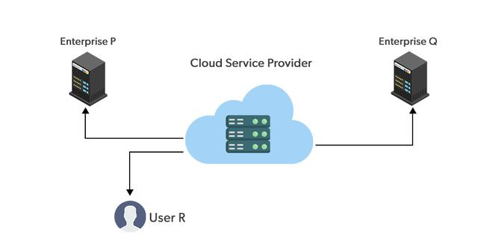
Public Cloud

Slide 34
Public cloud
The public cloud makes it possible for anybody to access systems and services. The public cloud may be less secure as it is open to everyone.
The public cloud is one in which cloud infrastructure services are provided over the internet to the general people or major industry groups.
The infrastructure in this cloud model is owned by the entity that delivers the cloud services, not by the consumer.
It is a type of cloud hosting that allows customers and users to easily access systems and services. This form of cloud computing is an excellent example of cloud hosting, in which service providers supply services to a variety of customers.
In this arrangement, storage backup and retrieval services are given for free, as a subscription, or on a per-user basis. For example, Google App Engine etc.

Slide 35
Advantages of the Public Cloud Model
Minimal Investment: Because it is a pay-per-use service, there is no substantial upfront fee, making it excellent for enterprises that require immediate access to resources.
No setup cost: The entire infrastructure is fully subsidized by the cloud service providers, thus there is no need to set up any hardware.
Infrastructure Management is not required: Using the public cloud does not necessitate infrastructure management.
No maintenance: The maintenance work is done by the service provider (not users).
Dynamic Scalability: To fulfill your company’s needs, on-demand resources are accessible.

Slide 36
Disadvantages of the Public Cloud Model
Less secure: Public cloud is less secure as resources are public so there is no guarantee of high-level security.
Low customization: It is accessed by many public so it can’t be customized according to personal requirements.

Slide 37
Private Cloud
It’s a one-on-one environment for a single user (customer). There is no need to share your hardware with anyone else.
The distinction between private and public clouds is in how you handle all of the hardware. It is also called the “internal cloud” & it refers to the ability to access systems and services within a given border or organization.
The cloud platform is implemented in a cloud-based secure environment that is protected by powerful firewalls and under the supervision of an organization’s IT department. The private cloud gives greater flexibility of control over cloud resources.

Slide 38
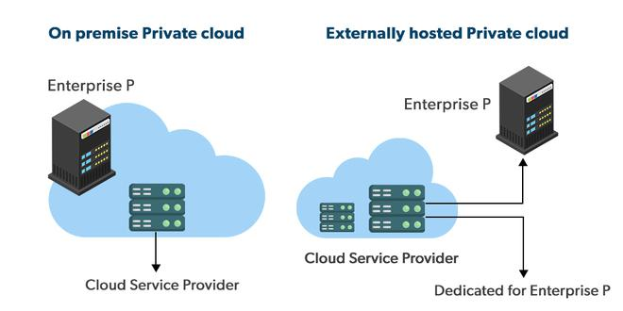

Slide 39
Advantages and disadvantages
Advantages of the Private Cloud Model
Better Control: You are the sole owner of the property. You gain complete command over service integration, IT operations, policies, and user behavior.
Data Security and Privacy: It’s suitable for storing corporate information to which only authorized staff has access. By segmenting resources within the same infrastructure, improved access and security can be achieved.
Supports Legacy Systems: This approach is designed to work with legacy systems that are unable to access the public cloud.
Customization: Unlike a public cloud deployment, a private cloud allows a company to tailor its solution to meet its specific needs.
Disadvantages of the Private Cloud Model
Less scalable: Private clouds are scaled within a certain range as there is less number of clients.
Costly: Private clouds are more costly as they provide personalized facilities.

Slide 40
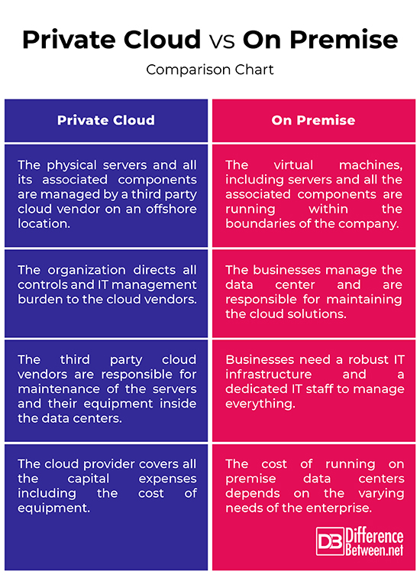

Slide 41
Hybrid Cloud
By bridging the public and private worlds with a layer of proprietary software, hybrid cloud computing gives the best of both worlds. With a hybrid solution, you may host the app in a safe environment while taking advantage of the public cloud’s cost savings. Organizations can move data and applications between different clouds using a combination of two or more cloud deployment methods, depending on their needs.
Hybrid cloud examples include financial firms using private clouds for sensitive data and public clouds for customer apps, streaming services like Netflix scaling with public cloud for demand spikes

Slide 42
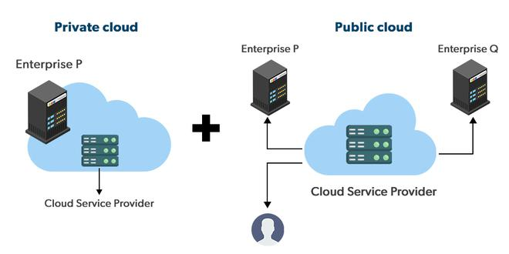
Hybrid cloud

Slide 43
Advantages and disadvantages
Advantages of the Hybrid Cloud Model
Flexibility and control: Businesses with more flexibility can design personalized solutions that meet their particular needs.
Cost: Because public clouds provide scalability, you’ll only be responsible for paying for the extra capacity if you require it.
Security: Because data is properly separated, the chances of data theft by attackers are considerably reduced.
Disadvantages of the Hybrid Cloud Model
Difficult to manage: Hybrid clouds are difficult to manage as it is a combination of both public and private cloud. So, it is complex.
Slow data transmission: Data transmission in the hybrid cloud takes place through the public cloud so latency occurs.

Slide 44
Community Cloud
It allows systems and services to be accessible by a group of organizations. It is a distributed system that is created by integrating the services of different clouds to address the specific needs of a community, industry, or business.
The infrastructure of the community could be shared between the organization which has shared concerns or tasks. It is generally managed by a third party or by the combination of one or more organizations in the community.

Slide 45
Examples of community cloud
Government (G-Cloud): Governments often use community clouds to securely share data across different departments. For example, AWS GovCloud is a community cloud specifically restricted to U.S. government agencies and their contractors to meet strict compliance standards.
Healthcare Industry: Hospitals, clinics, and labs use community clouds to store and exchange sensitive patient data while complying with regulations like HIPAA.
Financial Services: Banks and insurance companies utilize shared cloud environments to meet PCI DSS standards for data protection and fraud detection.
Scientific Research: Organizations like NASA or various research universities may share a community cloud to exchange massive datasets for scientific computing and collaborative experiments.
Military & Defense: NATO utilizes closed community cloud platforms to ensure secure and reliable data exchange among its member states.

Slide 46
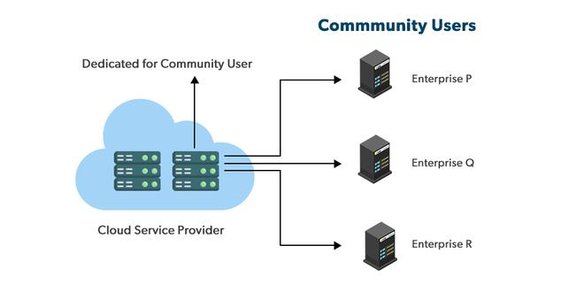
Community cloud

Slide 47
Advantages of the Community Cloud Model
Cost Effective: It is cost-effective because the cloud is shared by multiple organizations or communities.
Security: Community cloud provides better security.
Shared resources: It allows you to share resources, infrastructure, etc. with multiple organizations.
Collaboration and data sharing: It is suitable for both collaboration and data sharing.
Disadvantages of the Community Cloud Model
Limited Scalability: Community cloud is relatively less scalable as many organizations share the same resources according to their collaborative interests.
Rigid in customization: As the data and resources are shared among different organizations according to their mutual interests if an organization wants some changes according to their needs they cannot do so because it will have an impact on other organizations.

Slide 48
MULTI CLOUD
Multi-cloud in cloud computing is a strategy where an organization uses services from multiple public cloud providers (like AWS, Azure, Google Cloud) simultaneously,
rather than relying on just one, to optimize for best-fit services, avoid vendor lock-in, enhance resilience, and gain flexibility for different workloads.
This approach allows companies to select specialized tools, manage costs, improve performance, and build redundancy by distributing applications across various cloud environments.

Slide 49
Benefits
Best-of-Breed: Access to unique services and innovations from different vendors.
Cost Control: Ability to choose the most economical option for each workload.
Performance: Lower latency by placing services closer to users globally.
Challenges
Complexity: Requires more sophisticated management, security, and governance across disparate platforms.
Integration: Ensuring smooth interoperability between different cloud environments.

Slide 50
ARCHITECTURAL DESIGN OF COMPUTE AND STORAGE
The cloud architecture is divided into 2 parts
1. Frontend
2. Backend

Slide 51
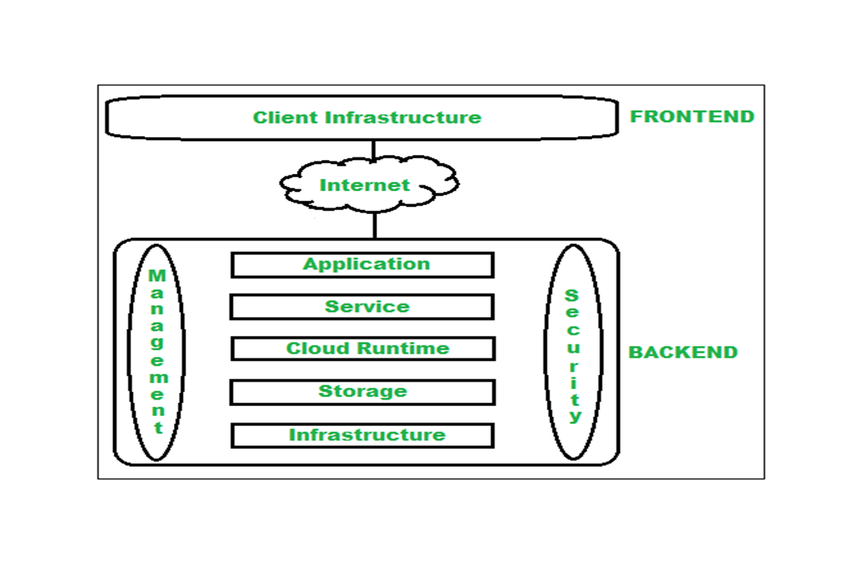

Slide 52
Cloud computing architecture
Architecture of cloud computing is the combination of both SOA (Service Oriented Architecture) and EDA (Event Driven Architecture). Client infrastructure, application, service, runtime cloud, storage, infrastructure, management and security all these are the components of cloud computing architecture.

Slide 53
Frontend:
Frontend of the cloud architecture refers to the client side of cloud computing system. Means it contains all the user interfaces and applications which are used by the client to access the cloud computing services/resources. For example, use of a web browser to access the cloud platform.
Client Infrastructure – Client Infrastructure is a part of the frontend component. It contains the applications and user interfaces which are required to access the cloud platform.
In other words, it provides a GUI (Graphical User Interface) to interact with the cloud.
Backend refers to the cloud itself which is used by the service provider. It contains the resources as well as manages the resources and provides security mechanisms. Along with this, it includes huge storage, virtual applications, virtual machines, traffic control mechanisms, deployment models, etc.

Slide 54
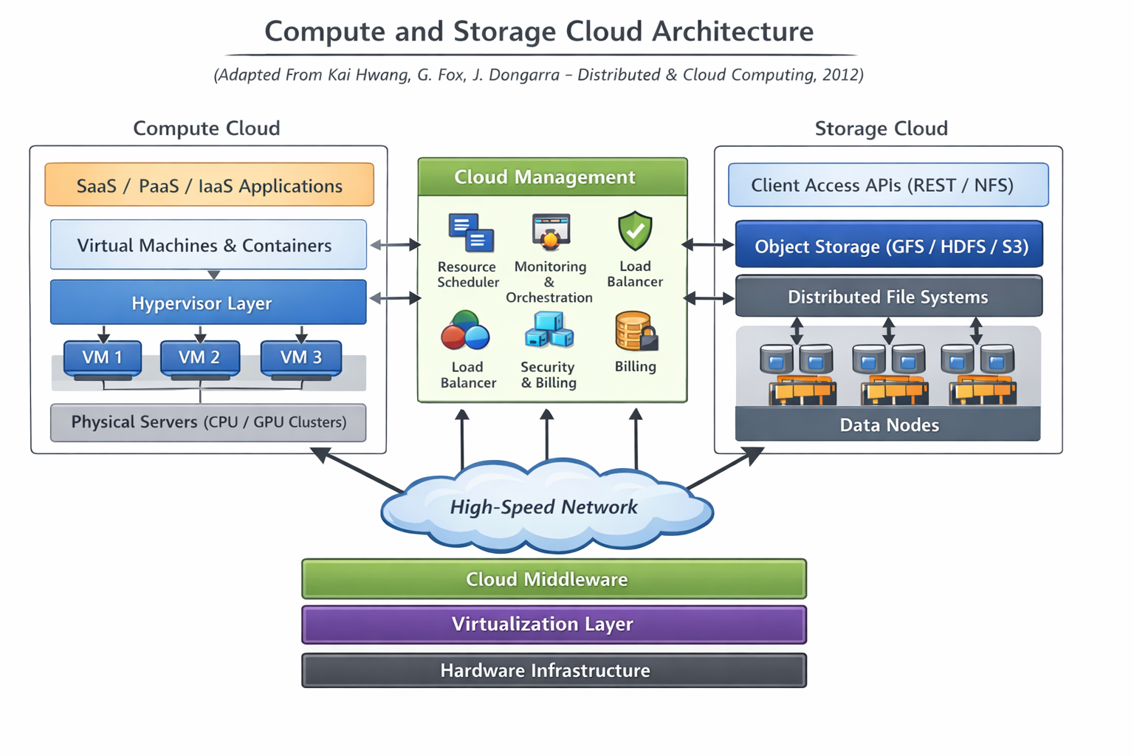

Slide 55
Compute Cloud Architecture
Compute clouds focus on delivering elastic processing power through virtualized resources.
a) Virtualized Compute Layer
This layer is the core of compute clouds. It consists of:
Physical servers with multi-core CPUs and GPUs
Hypervisors (Xen, KVM, VMware ESX)
Virtual Machines / Containers
Functions:
Isolation between tenants
Dynamic provisioning and scaling
Live migration and fault-tolerant execution
It is emphasized as the “virtual execution environment” that abstracts hardware.

Slide 56
Elastic Resource Provisioning
Compute architecture supports:
On-demand VM creation
Auto-scaling based on workload
Load balancing among VM clusters
Resource management is performed using:
Resource brokers
Job schedulers
Cloud controllers (OpenStack, Eucalyptus)
This ensures efficient use of distributed datacenter resources.

Slide 57
Compute Clusters and Data Center Organization
Clouds are built using large-scale:
Server clusters
Blade servers
Rack-mounted computing nodes
Server clusters, blade clusters, and rack-mounted nodes represent different approaches to organizing computer hardware for increased performance, reliability, and space efficiency in data centers.
Server Clusters: A logical grouping of multiple independent servers (nodes) that work together as a single system to provide high availability and load balancing.
Rack-Mounted Nodes: Individual, standalone servers (1U, 2U, etc.) designed to be bolted into a standard 19-inch metal frame (rack).
Blade Clusters: A high-density system where multiple ultra-thin "blade" servers are inserted into a single chassis, sharing power, cooling, and networking components.

Slide 58
The datacenter architecture integrates
High-speed interconnects (GigE, InfiniBand)
Distributed monitoring and control systems
According to the book, compute clouds follow a multi-tier architecture, involving:
Fabric Layer(physical level)
Unified Resource Layer(virtualization level)
Platform Layer(development level )
Application Layer(user and application level)

Slide 59
Storage Cloud Architecture Storage
Clouds provide persistent, scalable, and reliable data storage. classified storage into:
Block Storage (for VMs)
File Storage (NFS, DFS)
Object Storage (GFS, HDFS, Amazon S3)

Slide 60
Distributed File Systems
Distributed file systems such as Google File System (GFS) and Hadoop Distributed File System (HDFS) are key components.
Key characteristics:
Large file support
Data replication for reliability
Fault-tolerant
metadata management
High-throughput data access
These systems use a master/slave architecture, where a master node handles metadata.

Slide 61
Object-Based Storage
Object stores (like S3-style systems) provide:
Flat namespace
REST API access
Extremely scalable architecture
Objects are stored with:
Data
Metadata
Unique identifiers
object storage is the foundation for cloud big-data applications.

Slide 62
Storage Virtualization
Storage clouds use virtualization techniques such as:
Logical volume management
Virtual block devices
Virtualized storage pools
This supports:
Multi-tenancy
On-demand provisioning
Rapid data access

Slide 63
Integrated Compute–Storage Architecture
cloud architecture as a “loose coupling of compute and storage layers” connected by high-speed networks and controlled by cloud middleware.
Key Components:
Compute Layer – VM clusters, hypervisors
Storage Layer – distributed storage systems
Network Layer – backbone connecting compute and data
Cloud Management Layer – provisioning, billing, monitoring
Application Layer – SaaS, PaaS, IaaS workloads

Slide 64
Design challenges
Compute Scalability
Cloud systems must handle on-demand provisioning of VMs/containers.
Maintaining seamless scaling across heterogeneous hardware is difficult.
Auto-scaling requires accurate workload prediction algorithms.
Poor scaling can lead to resource contention or over-provisioning.
Storage Scalability
Storage must support exponential data growth.
Distributed storage systems like HDFS, Ceph, or AWS S3 need:
Efficient metadata management
Fast replication
Consistent access across data centers

Slide 65
DESIGN CHALLENGES
Fault Tolerance and Reliability
Compute and storage clouds must remain operational even if hardware fails.
Challenges
Designing redundancy without increasing cost excessively.
Ensuring zero-downtime failover for VMs and applications.
Maintaining data durability in storage (e.g., 11 nines in AWS S3).
Handling network partitions and avoiding split-brain scenarios.

Slide 66
Design challenges
Virtualization and Resource Management
Virtualization is the backbone of compute clouds.
Challenges
Providing strong isolation between tenants.
Reducing overhead from hypervisors.
Handling live migration of VMs without service disruption.
Ensuring fair resource scheduling (CPU, memory, I/O).

Slide 67
Data Consistency and Data Management
Storage clouds often follow eventual consistency, which introduces challenges.
Challenges
Achieving trade-off between consistency, availability, latency (CAP theorem).
Maintaining consistency during:
Replication
Sharding and rebalancing
Node failures
Supporting ACID transactions in distributed storage.

Slide 68
Network Challenges
Clouds are heavily dependent on high-performance data-center networks.
Challenges
High bandwidth requirements for:
VM migration
Data replication
Large-scale analytics jobs
Minimizing latency, packet loss, and network congestion.
Providing network isolation for multi-tenant environments (VLAN, SDN).

Slide 69
Security and Privacy
Security is a crucial architectural challenge.
Challenges
Protecting data in transit and at rest.
Designing multi-tenant isolation to avoid attacks.
Key management and access control policies in distributed storage.
Preventing data leakage, unauthorized access, and hypervisor attacks.

Slide 70
Energy Efficiency and Cost Optimization
Cloud data centers consume large amounts of energy.
Challenges
Managing cooling, power distribution, and energy-efficient servers.
Designing algorithms for energy-aware scheduling.
Reducing cost while maintaining performance.

Slide 71
Performance Optimization
Ensuring high throughput and low latency.
Challenges
Avoiding performance interference between tenants.
Reducing I/O bottlenecks in distributed storage.
Balancing compute and storage placement to minimize data movement.

Slide 72
Interoperability and Vendor Lock-in
Clouds use proprietary technologies.
Challenges
Ensuring compatibility between:
Private cloud ↔ Public cloud
Different cloud vendors
Designing portable APIs, container standards (Docker, Kubernetes), and open interfaces.

Slide 73
Monitoring, Management & Automation
Clouds require continuous monitoring and orchestration.
Challenges
Handling massive volumes of logs and metrics.
Automating fault detection and self-healing.
Implementing policy-driven resource orchestration.

Slide 74
Geographic Distribution
Storage clouds often span multiple regions.
Challenges
Data locality vs. latency.
Multi-region replication and failover design.
Meeting legal requirements (data residency, compliance).

